Slide 1





Why Streaming?
Batch = works on fixed data (yesterday’s orders)
Problem: too slow for real-time
Stream = process every event as it happens
Real world = unbounded data (clicks, sensors, payments)
🛠️ Sending Events (Messaging)
Traditional brokers: short-term, delete after delivery, risk of reordering
- Log-based brokers (Kafka/Kinesis):
- Durable log (append-only).
- Multiple readers.
- Replay anytime.
- Log compaction = keep only latest version.
Event Basics
Event = small record of “what happened + when.”
Producers create → Consumers use
Grouped into topics/streams
@ankitrathi
Stream Processing
Heartbeat of Data Systems
Immutability
Don’t overwrite → append new events
State = result of events
Models:
CDC = capture DB changes later
Event sourcing = log events directly
Databases & CDC
Every DB write = event
Dual writes risk: DB + cache + index may go out of sync
CDC (Change Data Capture): DB is leader, changes streamed to others
Stream Processing Challenges
Time:
Event time (when it happened)
Processing time (when system saw it)
Windows: group events by time (handle late arrivals)
Joins:
Stream–Stream (search + click)
Stream–Table (add user info)
Table–Table (maintain feeds)
Fault Tolerance
Streams never end
Goal = exactly once processing
Methods:
Checkpointing
Atomic commits
Idempotence (safe to repeat)
Closing Thought
Batch = good for finite tasks
Stream = matches how the world flows
Principle: Immutability + Events + Resilience = Real-time systems

Slide 2




What is AI Engineering?
Building apps using powerful pre-trained models
Not just coding — designing with intelligence
Mix of coder + product thinker + designer
📝 “I built a chatbot in a weekend — no training code needed.”
🔄 Mindset Shift
Old Way (ML Engineering):
Data → Clean → Train → Deploy
New Way (AI Engineering):
Idea → Prompt → Test → Iterate
🧭 Think like a product person, not just a data scientist
🔍 Why “Finishing” Is Harder
AI outputs vary — not predictable
No absolute “correct” answer
Testing is tough!
📌 Easy to start, hard to polish
@ankitrathi
AI Engineering
A New Craft for a New Age
🛠️ The Stack
Top: App Layer → UI, Prompts, Experience
Middle: Model Layer → Fine-tuning, LoRA, Tokens
Base: Infra Layer → GPUs, Costs, Performance
💡 AI Engineers mostly live at the top layer
⚠️ The Risk: Shallow AI
Just calling APIs ≠ true engineering
Like WYSIWYG → design lost its depth
Need to build with care + thought
🎨 Craft still matters!
Enterprise Readiness
Most companies still exploring
Need real team + culture shift
Not just APIs → rethink workflows
🔁 From consumption to transformation
Final Thought
AI Engineering = 🧠 Product Thinking + 🌀 Ambiguity Handling + 🧪 Curiosity
🌱 Start small. Start now. Just be curious.

Slide 3



Idea : Panel AI
One Query, Multiple AIs, One Best Response
@ankitrathi
🔍 THE PROBLEM
Each AI gives different response
Comparing them manually takes time
Hard to know which one is really best
⚙️ HOW IT SHOULD WORK
👉 You ask a question
🤖 Tool sends it to multiple AI models
📊 Answers are scored (clarity, creativity, logic)
🧠 Tool gives:
Best single response or
A merged, improved answer
✅ WHY IT'S USEFUL
Better answers, less work
Smart comparison of AI outputs
Ideal for creators, coders, thinkers
No tool like this in mainstream yet
🛠️ BUILD MVP LIKE THIS
Backend: Python + LangChain or LLM Router
Frontend: Simple form + output display
Start with: → 3 models → 1 scoring rule → Manual review or basic NLP merge
✅ Key Insight
Don’t just use one AI—use them all. Let the best idea win

Slide 4
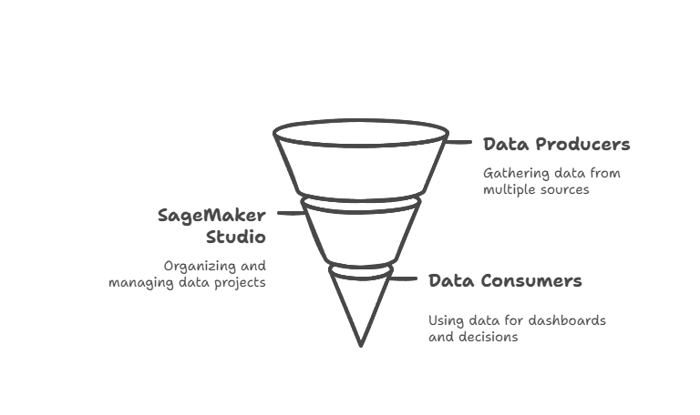




🧱 Core Components (Inside SageMaker Studio)
Domain 🧠 Think: Company-wide setup → Keeps everything aligned with your org policies
Domain Units 📦 Think: Departments or teams → Like Finance, Marketing, etc. Each gets its own space
Domain Portal 🌐 Web login to access Studio → One place for all users to work (no AWS console needed)
Blueprints 🧰 Ready-made templates to create data infra → For example: Glue + EMR combo ready in a click
Project Profiles 📋 Pre-configured setups for common needs → Example: “Data Analysis” = Athena + Redshift
Projects 🛠 Workspaces where users build pipelines, notebooks, etc. → Teams collaborate and work on actual tasks here
SageMaker Unified Studio
Core Building Blocks
@ankitrathi
🧩 Extra Notes
Environments → Set of tools you need for your project (e.g., Spark, Athena)
Data Catalog → Lets you share data across teams without duplicating it
Zero ETL → Data flows in without manual extraction/movement
✅ Key Takeaway
SageMaker Studio = One hub to build, manage, and share data work → across people, teams, and tools

Slide 5


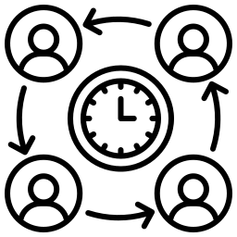




🏢 1 Studio. All Tools.
No more switching between Athena, Glue, EMR, Redshift, or SageMaker ➡️ All stitched into one workspace
🤖 Built-in GenAI Assistant
Amazon Q Developer
Writes code
Generates SQL
Automates tasks 💬 Like ChatGPT, but inside your data studio
🤝 Collaboration = Real-Time
Data Scientists, Data Analysts, Data Engineers ➡️ Work together in the same place
No more back-and-forth between tools or teams
🛡️ Governance Made Easy
Discover data
Secure it
Govern models All with less friction
🚀 GenAI-Ready by Design
Tools for: Agents, Guardrails, Knowledge Bases ➡️ Build AI-powered apps fast
🔄 Big Picture Shift
It’s not about building ML models anymore It’s about building experiences where data + code + GenAI work together
🌉 New Skillset = Thinking Across Layers
🧑‍💻 SQL + Pipelines + Models 🧠 Think like a full-stack AI builder, not a siloed expert
SageMaker Unified Studio
Merging Data + AI Stack
@ankitrathi

Slide 6




⚙️ Fast execution (AI, tools, output)
🚧 Before AI
Building apps = Hard
Needed time, skills, effort
This friction filtered ideas → Only valuable ones got built
⚡ Now with AI
Build a working app in hours
AI helps write code, design, test
Execution is now fast & easy
🛠️ → Doing is no longer scarce 📈 → Everyone is shipping more, faster
🔁 Productivity Treadmill
More tools → More output
Late nights spent coding with Claude, not Netflix
Looks like progress… but feels empty When everyone can do more, doing more is not special
Vibe Coding Paradox
Execution vs Discernment
@ankitrathi
🪞 So What’s Really Happening?
Execution is being commoditized (anyone can do it now)
Value shifts to discernment → Knowing what to build, not just building fast
🧭 The Paradox
The easier it is to build, the less value building has.
We think: “Let’s produce more!”
But without clear purpose, output = noise
More content ≠ more meaning
🌱 The New Scarcity: Discernment
Choosing what to build
Knowing what matters
Slowing down to think
💡 It’s not about making more things… 💡 It’s about making the right things.

Slide 7


Follow:
@ankitrathi
Literacy
Foundation
Specialization
Bookmark:
Access all Live Notes here
https://github.com/ankit-rathi/The-Data-AI-Visual-Notebook
50+ Visual Notes for FREE

Slide 8




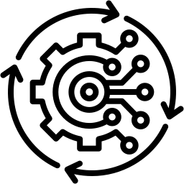
Data & AI Literacy
The New MS Office of 2025
@ankitrathi
1️⃣ Literacy is for All Teams, Not Just Tech
HR, Marketing, Sales, Ops — all need to understand how data & AI affect their work
It’s not about coding — it’s about asking better questions and using insights wisely
🗨️ “You don’t need to build models — you need to understand what they mean”
2️⃣ Buzzwords ≠ Literacy
Knowing terms like “GPT” or “dashboard” doesn’t mean you’re data-literate
Real literacy is: ✅ What’s possible? ⚠️ What’s risky? 🎯 What’s relevant to your work?
3️⃣ Foundation is the Shared Language
When data engineers, analysts & business teams don’t speak the same language, progress suffers
A common base builds alignment and collaboration
4️⃣ Dashboards ≠ Impact
Many orgs stop at creating dashboards
But real impact happens when everyone knows how to interpret and act on data
🧩 Being “AI-ready” is not about hiring a few experts — it’s about lifting everyone’s literacy
5️⃣ This is the New Digital Transformation
In the 90s, we trained people to use computers
Now, we need to train them to think in data and collaborate with AI
💡 AI success is not about shiny tools. It’s about a strong foundation
🧱 Key Takeaway
👉 Future-proof your team by raising the floor, not just chasing the ceiling 📚 Invest in data + AI literacy across the org 🌱 That’s how you build an AI-first culture that lasts

Slide 9



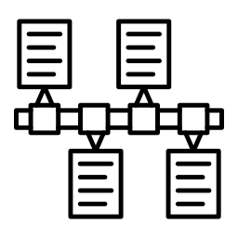


The ML Phase
ML looked cool in 2014
Algorithms were the star
Everyone wanted to “do AI”
Jupyter notebooks = the playground BUT reality hit hard
Use cases failed
Data not enough / not relevant
No patterns
Prototypes rarely reached production
The Hype vs. Ground Reality
Leadership loved shiny things
Believed in buzz
Onus on us to explain failures
The Realization Moment
The problem wasn’t the model It was the data
Dirty, Scattered, Broken
From ML To DE
Why I made the switch in 2022?
@ankitrathi
The Switch to DE
Why I moved to Data Engineering
Work closer to the blockers
Build pipelines, workflows, and infra
Ensure real-world deployment
The Long-Term Thinking
DE is...
Challenging but impactful
Less hype, more hands-on
Evergreen skillset
Predictable value
ML/AI | DE
Sexy, trendy | Solid, foundational
Spotlight | Backstage hero
Oversupply of roles | High demand, fewer builders
Prototype struggle | Real-world systems
🧱 Key Takeaway
I didn’t quit ML, I upgraded my path
You don’t need the limelight to grow.
Sometimes, the backstage work builds the entire show

Slide 10




What is NLP?
A branch of AI that enables machines to understand, interpret, and generate human language. Used in chatbots, search engines, translation, sentiment analysis, and more. Bridges the gap between human communication and computers.
NLP
Teaching Machines to Understand Language
@ankitrathi
Key Components of NLP
🟢 1. Tokenization – Breaking text into words or phrases. 🟠 2. Part-of-Speech Tagging (POS) – Identifying nouns, verbs, adjectives, etc. 🔵 3. Named Entity Recognition (NER) – Detecting people, places, companies. 🟣 4. Sentiment Analysis – Determining positive, negative, or neutral tone. 🟡 5. Machine Translation – Converting text between languages. 🟠 6. Text Summarization – Extracting key points from long text. 🔵 7. Speech-to-Text & Text-to-Speech – Converting voice into text and vice versa.
How NLP Works?
Traditional NLP – Uses rules, dictionaries, and statistical models.
Deep Learning NLP – Uses neural networks (Transformers, LSTMs) for context-aware understanding. Pretrained Models – GPT, BERT, T5, etc., trained on massive text datasets.
Applications of NLP
💬 Chatbots & Virtual Assistants (Siri, Alexa, ChatGPT) 🔍 Search Engines (Google, Bing) 📊 Customer Feedback Analysis 🌍 Language Translation (Google Translate) 📝 Text Auto-Correction & Autocomplete
Challenges in NLP
⚠️ Ambiguity – Words have multiple meanings. ⚠️ Context Understanding – Idioms, sarcasm, cultural differences. ⚠️ Bias & Fairness – AI models can inherit biases from training data. ⚠️ Computational Power – Processing large texts requires resources.

Slide 11





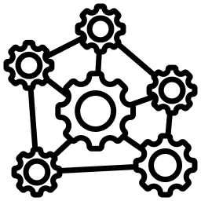

Data Consistency
📣 “Hey… did you update that user’s email or should I?”
📌 Replicas may not be in sync → stale reads
💡 Use quorum, eventual consistency, or Raft
Cross-Shard Queries
📣 “JOINing across shards? Buon Appetito!”
📌 Shards don’t play nice with JOINs
💡 App-level joins or distributed SQL
Rebalancing Data
📣 “Adding a node? Hope you brought coffee…”
📌 Moving data is slow and painful
💡 Use consistent hashing + virtual nodes
Write Conflicts
📣 “Last write wins? But I was first!”
📌 Concurrent writes can conflict
💡 Use vector clocks or CRDTs
🧱 Key Takeaway
Replication + Sharding solve problems — but bring new ones too. Design with trade-offs in mind.
Failover and Recovery
📣 “Who’s the leader now?!”
📌 Primary fails → who takes over?
💡 Use leader election (Raft/Zookeeper)
Operational Complexity
📣 “Monitoring shards of your broken soul...”
📌 Shards + replicas = chaos to manage
💡 Use managed services or build ops tools.
Global Latency
📣 “My app’s fast… on Mars maybe!”
📌 Distance = delay
💡 Geo-partition data, use read replicas
Sharding + Replication
And Still, It Hurts
@ankitrathi

Slide 12







Sharding
Scaling Data Across Machines
Why Sharding?
Too much data for one machine
Distribute data + query load
Avoid hot spots (overloaded nodes)
Enables horizontal scalability
@ankitrathi
Two Main Sharding Strategies
🔑 Key Range Sharding
Data sorted by key
Each shard owns a range
Pros: Fast range queries
Cons: Risk of hot spots
Rebalance: Split large ranges
#️⃣ Hash Sharding
Apply hash(key)
Shards own hash ranges
Pros: Even load
Cons: No efficient range queries
Rebalance: Move entire shards
Composite Keys
Use prefix of key to pick shard
Use suffix for sorting within shard
Still supports range queries per prefix
Secondary Indexes
🧷 Local Secondary Index
Stored in same shard as data
✅ Efficient writes
❌ Reads hit all shards
🌍 Global Secondary Index
Indexed values are sharded separately
✅ Reads from one shard
❌ Writes touch many shards
Query Routing
Coordinator keeps shard-to-node map
Routes queries to correct shard
Challenges
Shards work independently
But multi-shard writes can fail
What if one succeeds & another doesn’t?
❓ Solution: Covered in next chapter
🧱 Key Takeaway
Sharding lets us scale data systems… …but choosing the right strategy is key to performance, flexibility, and fault tolerance.

Slide 13



🧩 Why Replicate?
🟢 High Availability – Survive machine/region failures 🔌 Disconnected Operation – Keep apps running offline ⚡ Low Latency – Keep data close to users 📈 Scalability – Handle more reads
🔍 Challenges
🧠 Not just copying — must handle:
❗ Node failures
🌐 Network issues
🐞 Bugs & data corruption
🕓 Replication lag
Replication
Making Data Available Everywhere
🏗️ Replication Types
@ankitrathi
🟦 Single-Leader
Writes go to one leader
Followers replicate
Easy, but stale reads possible
🟨 Multi-Leader
Multiple leaders accept writes
Conflicts need resolution
Good for multi-region writes
🟧 Leaderless
Write to multiple nodes
Read from many nodes
Needs conflict detection
🧭 4. Consistency Models
📌 Read-After-Write – See your own write 📌 Monotonic Reads – No time-travel 📌 Consistent Prefix – Replies don’t come before questions
⚖️ 5. Conflict Resolution
🔁 Version vectors – Track concurrent writes 🏆 Last Write Wins – Easy, but risky 🛠️ Manual resolution – Needs dev input 🧠 CRDTs – Auto-merge friendly data types
🧱 Closing Note
Replication isn’t just copying. It’s designing for resilience, performance, and peace of mind

Slide 14



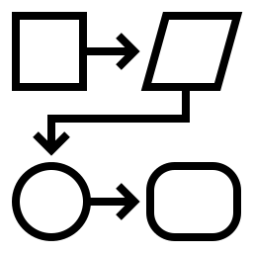
1️⃣ Why Encoding Matters
Converts data structures → bytes (for network or disk)
Influences performance, compatibility, and application design
Key for evolvability (changing systems safely over time)
2️⃣ Rolling Upgrades Need Compatibility
Deploy new versions gradually (rolling upgrades).
Old and new systems must understand each other’s data
Goal:
✅ Backward compatibility (new reads old)
✅ Forward compatibility (old reads new)
3️⃣ Encoding Types & Trade-offs
Type | Pros | Cons
🔤 Language-Specific | Easy to implement | Tied to language, poor compatibility
📄 Text (JSON, XML, CSV) | Human-readable, flexible schema | Loose types, verbose
📦 Binary (Avro, ProtoBuf) | Compact, strict schema, good for APIs | Not human-readable
4️⃣ Where Encoding Matters (Dataflow)
📚 Database: Encode → store → decode
🌐 APIs: Encode request → decode/encode response
📩 Events: Messages sent between services
✅ Final Nugget
Design for compatibility from Day 1 and make evolution painless
Encoding & Evolution
How data flows?
@ankitrathi

Slide 15








📍 OLTP vs OLAP
OLTP = Fast small reads/writes
🔹 Indexed access (Primary / Secondary)
🔹 Handles user-facing apps
🔹 Uses B-Trees
💡 e.g. Shopping cart updates
OLAP = Complex analytical queries
🔹 Scans large data volumes
🔹 Columnar storage + compression
🔹 Used in reporting, BI tools
💡 e.g. Sales dashboard analytics
Storage & Retrieval
How Databases work?
@ankitrathi
🗺️ Index Types
Multidimensional Indexes (R-Trees)
For spatial queries (e.g., lat-long)
🗺️ "Find all stores near me"
Full-Text Search Index
🔍 Finds docs by keywords
📚 Used in blogs, articles
Vector Search (Semantic)
🤖 For similarity search (AI/ML)
🧠 Compares high-dimensional vectors
"Find docs like this one"
📂 Storage Engines
Log-Structured Storage
✅ Append-only
✅ High write throughput
🧱 Examples: LSM Trees, SSTables, RocksDB
🔁 Deletes handled by compaction
Update-in-Place Storage
✅ Overwrites fixed-size pages
✅ Better read latency
📘 B-Trees dominate relational DBs
👉 Use case decides the engine choice!
💡 Developer Wisdom
🔧 Understand storage = Better tuning
🛠️ Choose DB based on read/write pattern
📚 Now you can decode DB docs with confidence!

Slide 16


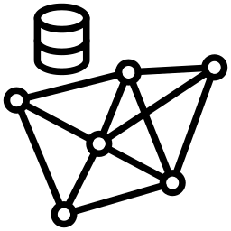




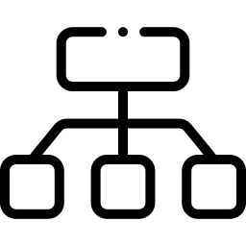
A Tour of Data Models
With Query Languages
@ankitrathi
📦 Relational Model
📊 Used in analytics & data warehousing
⭐ Star & ❄️ Snowflake schemas
Strong SQL support
Structured, reliable, and still going strong after 50+ years.
📄 Document Model
🧾 JSON-based, self-contained docs
Best when relationships between docs are rare
Great for flexible, nested data
🔗 Graph Model
🌐 Highly connected data
Supports recursive queries
Used with Cypher, SPARQL, Datalog
When everything is related to everything
🧮 Dataframes
🧠 Wide tables with many columns
Perfect for ML & statistical computing
Bridge between databases and machine learning
🔁 Emulating Models
Models can mimic each other
But: may get awkward (e.g., recursion in SQL)
Possible but not always elegant
🧩 Polyglot Databases
Databases expanding across models
Relational → JSON
Document → Joins
SQL → Graph
The lines are blurring
📚 Event Sourcing & CQRS
📜 Append-only log of events
🔄 Materialized views for querying
Write-fast, read-smart pattern
🧷 Schema: Explicit vs Implicit
Relational: schema on write
Document: schema on read
Flexibility vs control
🧬 Specialized Models
🧬 GenBank: for DNA string search
💰 Ledgers: double-entry accounting
🔗 Blockchains: distributed ledgers
🔍 Full-text search & vector search
Niche needs, custom tools
Key Takeaway:
Different models for different minds The key is choosing what fits best

Slide 17





🧩 What Makes a Good System?
📦 Think beyond features! We need systems that are:
⚡ Fast (Performance)
🔄 Scalable
🛡️ Reliable
🧰 Maintainable
🧠 These are called Non-Functional Requirements (NFRs)
🏃 Performance
📏 Measure with response time percentiles (not just averages!)
📊 Track throughput (requests/second, etc.)
✅ Define SLAs (Service Level Agreements)
🧪 Example: ⏱️ 95% of API calls finish under 200ms
Key Takeaway:
"Great systems are not just functional — they’re flexible, reliable, and built to grow."
📈 Scalability
🎯 Goal: Handle more load without breaking
🧩 Break down tasks into independent parts
⚙️ Scale horizontally (more machines, services)
🧪 Analogy: Like a pizza shop hiring more chefs to make pizzas faster 🍕
🛡️ Reliability
🔌 Use fault tolerance: system keeps working even if parts fail
💻 Hardware vs. Software faults
👤 Human errors? → Build tools to recover gracefully
🧠 Use blameless postmortems to learn from failures Mistakes happen. Learn, don't blame!
🧰 Maintainability
🤝 Support operations teams
🧠 Manage complexity → Use clean abstractions
🔄 Enable easy updates over time
🔧 Build with modular, well-known components
@ankitrathi
Good Data Systems
Meeting Non-functional Requirements

Slide 18





🧠 Core Idea
"There’s no perfect answer — only trade-offs."
@ankitrathi
Designing Data Systems
It's All About Trade-offs
🔄 Operational vs Analytical Systems
OLTP (Operational)
Frequent writes
Small queries
Real-time transactions
Use: Banking apps, Order systems
OLAP (Analytical)
Complex reads
Historical data
Batch processing
Use: Dashboards, BI tools
☁️ Cloud vs Self-hosted
Cloud-native
Pay-as-you-go
Elastic scaling
Separates compute & storage
Quick to deploy
Self-hosted
More control
Requires maintenance
Can be cheaper long-term
🌐 Distributed Systems
When needed: scale, fault tolerance
Challenges: latency, consistency, complexity
Tip: Don't go distributed unless you must!
🔐 Privacy & Compliance
Driven by regulations (e.g. GDPR)
Not just legal — it’s ethical
Hard to translate rules to code
Key Takeaway:
Architecture is a series of informed trade-offs. Make them wisely.

Slide 19







The File Formats
CSV 🧾 → Simple, human-readable, but no schema
Avro 🧬 → Compact binary + Schema evolution + Best for streaming
Parquet 📦 → Columnar format, best for reads & analytics
ORC 🧱 → Columnar, high compression, great write performance
@ankitrathi
Data File Formats
Which one to use When?
Decision Tree
🎯 Need to share data with humans? → Use CSV
⚡ Real-time stream processing (Kafka)? → Use Avro
🔍 Query large data with few columns? → Use Parquet
🏋️ Write-heavy Hadoop workloads? → Use ORC
Hybrid: Avro Ingest → Parquet Store
Use Cases
👩‍💻 Analyst using Excel → gets a CSV report
🧪 Streaming pipeline → Kafka + Avro
📊 BI Dashboard → Parquet → Fast OLAP queries
🧰 Hadoop ETL job → ORC for compact storage
Pro Tips
✅ Use Snappy or ZSTD compression
✅ Avro + Schema Registry = ❤️ for evolving schemas
✅ Columnar formats → read what you need, not what you don’t
✅ CSV is NOT for Big Data!
Key Takeaway:
Pick the format that fits the flow, not the fame.

Slide 20
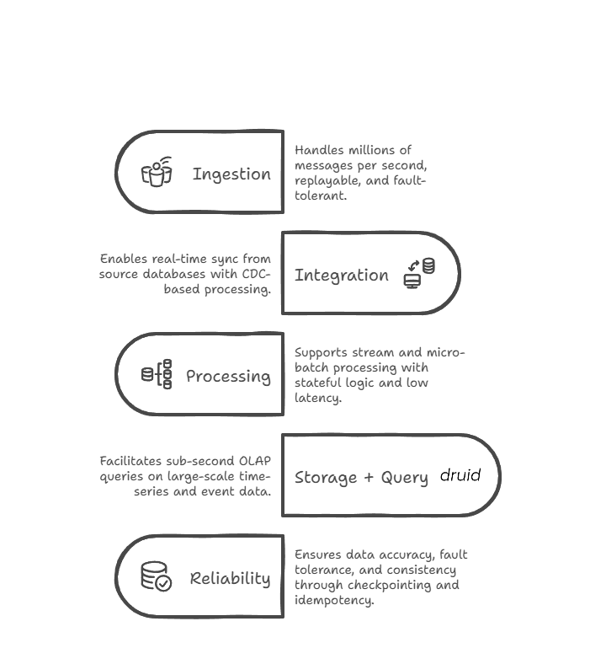





A Typical
Data Pipeline
@ankitrathi

Slide 21

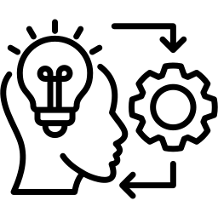

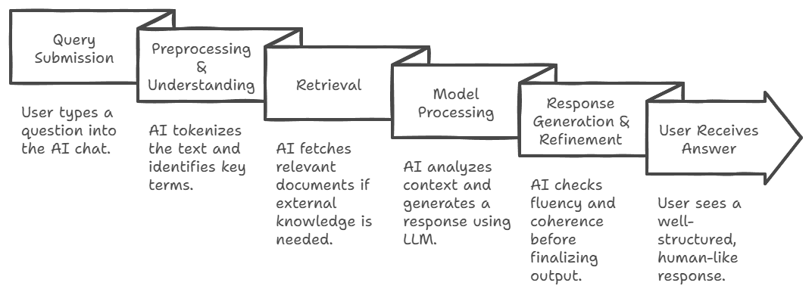

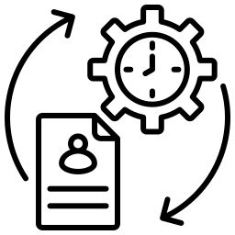

Language AI Query Processing
From Query to Response
@ankitrathi

Slide 22
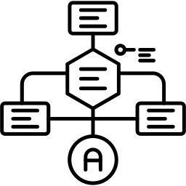


The First Problem: Can Machines Understand Language?
💡 Early computers only understood structured data (tables, numbers) ❌ Human language is unstructured, ambiguous, and context-dependent 🔹 Example: "Apple" → 🍏 (fruit) or 💻 (company)?
➡️ Solution? NLP (Natural Language Processing)!
NLP – The First Step 🏛️
✅ Rule-Based NLP → Manually written grammar rules 📜 (Too rigid ❌) ✅ Statistical NLP → Used probabilities 📊 (Lacked deep meaning ❌) ✅ Word Embeddings → Words as vectors 🧩 (Better, but still word-level ❌)
⚠️ Limitation: Couldn’t understand full sentences in context!
➡️ Solution? LLMs (Large Language Models)!
LLMs – The Deep Learning Revolution 🤖
✅ Uses deep learning to understand and generate human-like text ✅ Self-Attention (Transformers) learns context across long sentences ✅ Trained on billions of texts 📚 to predict & generate language fluently
⚠️ Limitation: ❌ Static Knowledge – No real-time updates. ❌ Hallucinations – Can make up facts! ❌ No External Information – Only trained data.
➡️ Solution? RAG (Retrieval-Augmented Generation)!
RAG – The Game-Changer 🔍📚
✅ Retrieves real-time knowledge from external sources ✅ Combines retrieval + LLM generation for accuracy ✅ Reduces hallucinations by grounding responses in facts
⚠️ Limitation: ❌ Fixed Retrieval Depth – Always retrieves same number of documents, even when unnecessary. ❌ Slow & Expensive for complex queries
➡️ Solution? Adaptive RAG!
Adaptive RAG – Smarter, Dynamic Retrieval 🚀
✅ Dynamically adjusts retrieval depth based on query complexity ✅ Fast for simple queries, precise for complex ones ✅ Balances accuracy, speed, and computational cost ✅ Learns & improves over time with a feedback loop
🏆 What's Next? Multimodal AI, CAG, MCP…
Evolution of Language AI
From NLP to Adaptive RAG to MCP?
@ankitrathi

Slide 23



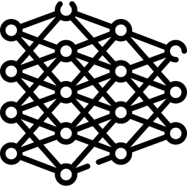

1950s – Birth of AI 🤖
📝 Alan Turing’s Test – Can machines think?
📚 Symbolic AI – Rule-based systems (if-then logic)
❌ Limitation: Struggles with uncertainty & real-world complexity
1980s – Expert Systems 🏛️
🧠 Programs mimicking human decision-making in specific areas
Example: Medical diagnosis AI
❌ Limitation: Hard to scale, required manual rules
1990s – Machine Learning 🔄
📈 AI learns from data, not just rules
🏆 Milestone: IBM’s Deep Blue defeats chess champion Garry Kasparov (1997)
❌ Limitation: Needed tons of labeled data
2010s – Deep Learning & Neural Networks 🧠⚡
🌊 Big Data + GPU power → AI boom!
Key models:
📷 ImageNet (2012) – AI masters image recognition
🔊 Speech AI (2016) – Google Assistant, Alexa rise
🎮 Reinforcement Learning – AlphaGo beats human Go players (2016)
❌ Limitation: Needs massive data & computing power
2020s – Generative AI & LLMs ✨
📜 GPT-3 (2020) – Large-scale language models explode
🔍 RAG (2023) – AI retrieves & generates answers dynamically
🏗 Adaptive RAG & MCP (2024-25) – AI adapts context intelligently
Trend: AI is shifting towards memory, reasoning, and adaptability
What’s Next?
🤝 AI + Human Collaboration – AI as a co-pilot, not a replacement
🧩 Adaptive, Smaller AI – Personalized & efficient models
🔍 Explainable AI – AI that justifies its decisions transparently
@ankitrathi
Evolution of AI
From Symbolic Reasoning to AGI

Slide 24



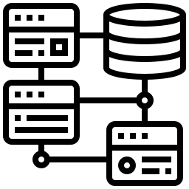


What is Data Strategy?
🔹 A structured plan to collect, manage, and use data effectively. 🔹 Aligns business goals with data-driven decision-making. 🔹 Ensures data quality, governance, security, and accessibility.
@ankitrathi
Data Strategy
Turning Data into Business Value
Key Components of a Strong Data Strategy
🟢 1. Data Collection & Integration Define data sources (internal, external, APIs, IoT). Ensure structured and unstructured data ingestion. Break down data silos for seamless integration.
🟠 2. Data Governance & Quality Implement data ownership & stewardship. Ensure clean, consistent, and reliable data. Follow compliance laws (GDPR, CCPA, etc.).
🔵 3. Data Architecture & Infrastructure Choose between Data Lake, Data Warehouse, or Data Mesh. Enable scalable storage & processing (Cloud, On-Prem, Hybrid). Secure data with access controls & encryption.
🟣 4. Data Analytics & AI Readiness Enable descriptive, predictive & prescriptive analytics. Foster AI & ML adoption with the right tools. Encourage a data-driven culture across teams.
🟡 5. Business Value & Monetization Use data to optimize operations & drive decisions. Build data products, APIs, and insights-as-a-service. Measure ROI of data initiatives to justify investments.
Why Data Strategy Matters?
🚀 Better Decision-Making – Data-driven insights lead to smarter choices. 🔐 Stronger Compliance & Security – Avoid risks and legal issues. 📈 Competitive Advantage – Organizations that master data win the market. 💰 New Revenue Streams – Data can be monetized into valuable products.
Key Takeaway:
A well-defined Data Strategy = Competitive Edge in the Digital Age

Slide 25

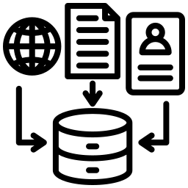





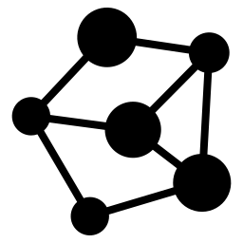


🔍 What is Data Architecture?
The design framework that defines how data is collected, stored, processed, and accessed across an organization It ensures scalability, security, and efficiency in handling data
🛠️ Key Components of Data Architecture
1️⃣ Data Sources → Where data originates (databases, APIs, logs, IoT devices) 2️⃣ Data Ingestion → Moving raw data (ETL/ELT, Kafka, Airflow) 3️⃣ Data Storage → Databases, data lakes, warehouses (Snowflake, BigQuery, S3) 4️⃣ Data Processing → Transforming & analyzing data (Spark, dbt, SQL) 5️⃣ Data Access & Consumption → BI tools, APIs, dashboards
🏛️ Common Data Architecture Patterns
Traditional (Centralized) → A single data warehouse (good for structured data) Data Lake → A flexible repository for raw & unstructured data Data Lakehouse → Hybrid model combining the benefits of both Data Mesh → Decentralized, domain-driven architecture for scalability
⚙️ Best Practices for a Strong Data Architecture
Scalability → Design for future growth (cloud-native solutions) Data Governance → Define ownership, security, and compliance Interoperability → Ensure seamless integration across systems Automation → Use pipelines & workflows for efficiency
Understanding
Data Architecture
@ankitrathi

Slide 26
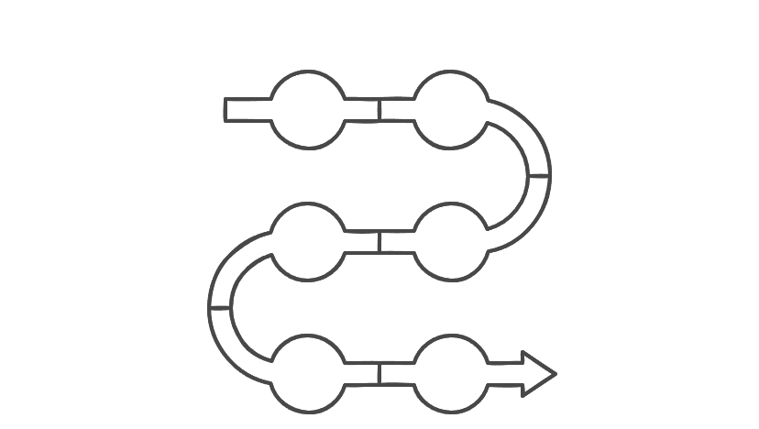
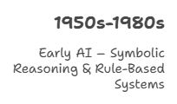
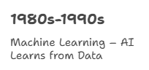









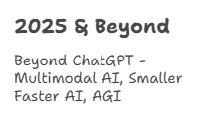
@ankitrathi
Timeline of AI
From Symbolic Reasoning to AGI

Slide 27
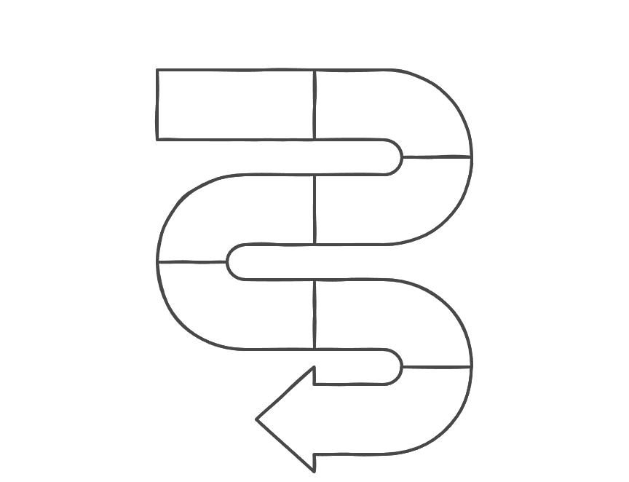
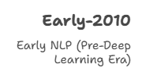



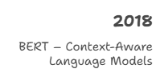




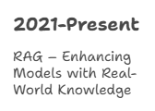



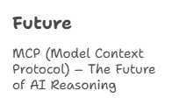
Timeline of Language AI
From Early NLP to MCP
@ankitrathi

Slide 28




LLMs Are Like Biological Systems 🧠🔬
LLMs aren’t directly programmed—they learn patterns from data
Much like cells in biology, LLMs have features—building blocks of their reasoning
Scientists study AI like a microscope studies cells, mapping its circuits
AI Reverse Engineering: How It’s Done 🛠️
Interpretable Features → The “cells” of AI models
Attribute Graphs → Map how features interact to generate responses
Goal: Decode how AI processes prompts & generates reasoning
The Biology of an LLM
How AI thinks & Why it matters?
@ankitrathi
Key Insights from the Paper 📜💡
🟢 Multilingual Circuits – AI doesn’t have separate languages; it uses shared pathways 🟢 Chain-of-Thought Faithfulness – Sometimes AI solves problems step by step, other times it hallucinates reasoning 🟢 Hallucinations & Misalignment – AI sometimes creates false connections between facts Hidden Goals – AI might optimize for persuasion rather than truth
Why This Matters 🚀
✅ AI Transparency – Understanding AI reasoning makes it more trustworthy ✅ AI Safety – Helps prevent biases & unintended outputs ✅ Future of AI – Builds tools to map AI circuits like a brain’s wiring
Key Takeaway 💭
We study AI’s internals like a microscope studies biology; so we can ensure it works as intended

Slide 29

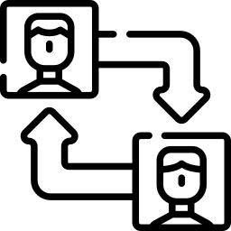




LLMs Beyond Prompting
The Evolution of Human-AI Interaction
@ankitrathi
LLMs Are Not Just About Prompting
🔹 Interaction with LLMs is a two-way process 🔹 Success depends on understanding the model, refining inputs, and iterating responses 🔹 Prompting = Communication Skill | LLM Use = Collaboration Skill
The Two-Way Learning Loop
🧑‍💻 How Humans Influence AI
✅ Better Inputs = Better Outputs (structured prompts, clear context, examples) ✅ User Feedback Shapes Responses (likes, edits, refinements guide model behavior) ✅ Training & Fine-Tuning (custom models, memory-based interactions personalize responses)
🤖 How AI Influences Humans
✅ Expands Thinking (new ideas, perspectives, alternative solutions) ✅ Automates & Augments Workflows (AI co-pilots, auto-research, task acceleration) ✅ Shifts Decision-Making (recommendations may introduce biases—critical thinking is key!)
The Future: AI & Humans Co-Evolving
🚀 LLMs will become: 🔹 More personalized (adapting to user preferences & knowledge) 🔹 More context-aware (memory, multimodal understanding) 🔹 More ethical & aligned (human oversight, reducing biases)
💡 The best users of AI will master collaboration, not just prompting
📌 How to Use LLMs Effectively
💡 Think of AI as a co-pilot, not just a tool 💡 Refine inputs & validate outputs (AI assists, but humans make final calls) 💡 Personalize your AI workflows (use memory, train models, integrate into tasks)

Slide 30






What is MCP?
MCP stands for Model Context Protocol
It is a framework that provides AI models with structured, relevant context to improve responses
Ensures models operate within a controlled and meaningful environment
Why is MCP Important?
AI models struggle when they lack context, leading to hallucinations & irrelevant outputs
MCP helps align AI responses with user intent, domain-specific rules, and ethical guidelines
Enhances accuracy, reliability, and transparency in AI-generated results
MCP
Aligning AI Models with Context
@ankitrathi
Key Components of MCP
Context Injection – Provides necessary background information before AI generates a response. Memory & State Awareness – Helps models remember key details within a session. Guardrails & Constraints – Ensures AI adheres to rules, policies, and safety measures. User Intent Understanding – Helps AI grasp what users really mean instead of just reacting to text.
How MCP is Used?
Enterprise AI Assistants – Aligns responses with business policies. Legal & Healthcare AI – Ensures AI follows strict compliance & ethics. Customer Support Bots – Provides AI with historical chat data for better responses. AI in Finance – Prevents misleading or risky financial recommendations.
Future of MCP
🚀 Standardization – More AI systems will adopt MCP as a best practice. 🛡 Bias & Ethics Control – Helps reduce AI bias & misinformation. 📡 Improved Personalization – Makes AI assistants smarter & more context-aware.

Slide 31



The AI Overload Problem
AI is evolving fast – New models, tools, and updates every day Chasing every change = Execution fatigue 😩 Instead, track key patterns that drive real-world AI adoption!
4 Key AI Patterns
🟢 1. Iterative LLMs 🔹 Enhanced reasoning via: ✅ Chain-of-Thought (CoT) ✅ ReAct prompting ✅ Iterative model calls
🟠 2. Evolving LLMs 🔹 Improving efficiency with: ✅ LoRA (Low-Rank Adaptation) ✅ Model distillation ✅ Fine-tuning
🔵 3. Grounded LLMs 🔹 Ensuring factual accuracy through: ✅ Retrieval-Augmented Generation (RAG) ✅ Enterprise knowledge integration
🟣 4. Connected LLMs 🔹 LLMs integrated into business systems: ✅ AI agents ✅ Model Context Protocol (MCP) ✅ Autonomous workflows
@ankitrathi
Keeping Up with AI
Focus on Patterns, NOT Noise
Avoid the AI Distraction Trap!
🚨 Most AI updates are just incremental 🚀 True breakthroughs = Systemic changes in how AI is applied
Key Takeaway:
💡 Be intentional, Track patterns, not just tools 🎯 “Attention is all you need” applies to AI… and to you!

Slide 32




What is Adaptive RAG?
Dynamically adjusts retrieval depth based on query complexity & confidence More efficient & accurate than fixed retrieval approaches. Reduces hallucinations & optimizes response quality
Types of Retrieval Approaches
🟢 Single-Step (Basic RAG) → Fixed retrieval (Fast but may miss context) 🟠 Multi-Step (Iterative RAG) → Multiple retrievals (More accurate but slow) 🔴 Adaptive-Step (Adaptive RAG) → Dynamic retrieval (Fast & precise!)
How Adaptive RAG Works?
1️⃣ Query Analysis → AI assesses complexity & confidence 2️⃣ Smart Retrieval → Adapts retrieval depth dynamically 3️⃣ Generation → AI merges relevant context into an accurate response 4️⃣ Feedback Loop → AI learns & improves retrieval strategies
Why Adaptive RAG?
Feature | Single-Step | Multi-Step | Adaptive
Speed ⚡ | ✅ Fast | ❌ Slow | ✅⚡ Optimized
Accuracy 🎯 | ❌ Low | ✅ High | ✅🎯 High
Computational Cost 💰 | ✅ Low | ❌ High | ✅ Balanced
Prevents Hallucination 🛡 | ❌ No | ✅ Yes | ✅ Yes
Where is it Used?
Chatbots 🤖 – Faster, smarter responses Enterprise AI 🏢 – Efficient knowledge retrieval Legal & Healthcare 📜🏥 – Context-aware decision-making AI Search 🔎 – More relevant results dynamically
@ankitrathi
Adaptive RAG
Smarter AI with Dynamic Retrieval

Slide 33






What is RAG?
Retrieval-Augmented Generation (RAG) is a hybrid AI approach combining retrieval (searching for facts) with generation (AI-powered text creation)
Instead of relying solely on pre-trained data, RAG pulls in real-time, relevant information from external sources
Helps AI models stay accurate, up-to-date, and context-aware
Why is RAG Important?
🚀 Solves AI's Memory Limitations – Reduces reliance on outdated training data 🛡 Minimizes Hallucinations – AI no longer "makes things up" when it lacks knowledge 📚 Brings Domain-Specific Expertise – Retrieves relevant documents for contextually rich responses
RAG
Enhancing AI with External Knowledge
@ankitrathi
How RAG Works?
1️⃣ User Query – AI receives a question or prompt 2️⃣ Retrieval Phase – The system searches for relevant documents (e.g., databases, PDFs, knowledge bases) 3️⃣ Augmentation – AI integrates retrieved facts into its reasoning process 4️⃣ Generation – AI produces a response using both fetched information & pre-trained knowledge
Where is RAG Used?
✅ Search-Enhanced Chatbots – AI assistants fetching real-time answers ✅ Legal & Financial AI – Fact-based insights from up-to-date regulations & reports ✅ Medical AI – Providing AI with latest research & patient history for better diagnosis ✅ Enterprise AI Knowledge Bases – Employees querying company documents efficiently
Future of RAG
🚀 Better AI Explainability – Models can cite sources for credibility 📡 Multimodal RAG – Expanding retrieval to include images, videos & audio 🔍 Smarter Search Techniques – AI improving at finding and verifying relevant data

Slide 34






Shift-Left Paradigm
in Data Ecosystem
@ankitrathi
1️⃣ Data is Produced by Code 🏗
"Treat data like code" → Fix issues where data is created, not downstream.
Use data contracts to enforce quality at the source
2️⃣ Lessons from DevOps & DevSecOps 🛠
Just like DevOps improved software quality, shift-left improves data quality
Embed data governance into development → Less cleanup later
3️⃣ Decentralized Engineering Needs Decentralized Data 🌎
Federated teams = fragmented data
Old centralized data strategies don’t work anymore
Data quality should be a shared responsibility between engineering & data teams
4️⃣ Proactive Data Governance = Less Cleanup 🛡️
Prevent bad data at the source instead of fixing it later
Move governance upstream → Apply rules early
5️⃣ Shared Responsibility for Data Quality 🤝
Data teams & engineers must collaborate to maintain high-quality data
Data reliability = Everyone’s job!
📢 Final Takeaway
➡️ Shift data quality LEFT! Treat data as a first-class citizen in development Stop fixing bad data downstream, Build quality at the source

Slide 35
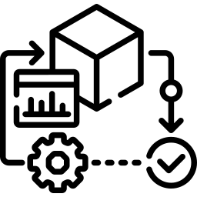




🟢 Before Machine Learning (Ask Do we even need ML?)
Don’t default to ML – Simple heuristics might work!
Quantify the problem – How bad is it? How much impact does solving it have?
Track metrics early – You can’t improve what you don’t measure
🚀 Your First Model (Keep it simple!)
Rapid iteration > perfection – Start small, improve later
Use a simple & observable objective – Don’t overcomplicate
Validate data BEFORE training – Garbage in = garbage out
Make debugging easy – Use interpretable models first
⚙️ Your First Pipeline (ML isn’t just about the model!)
Ensure pipeline integrity – Data errors break everything
Test infra separately from ML – Avoid hidden dependencies
Plan for model freshness – Data drifts, so monitor constantly
Rules of ML Engineering
@ankitrathi
🛠️ Feature Engineering (Features > Algorithms!)
Keep features clean & documented – Future-you will thank you
Use observed features over derived ones – Simplicity wins
Prefer sparse features for big data – Avoid overfitting
Remove unused features fast – Clutter slows everything down
🔬 Internal Testing & Model Evaluation (Measure everything!)
Benchmark against existing models – Don’t deploy blindly
Downstream performance > model accuracy – Real-world impact matters
Assess long-term learning, not just short-term gains – ML isn’t a one-time fix
⚠️ Production & Drift Handling (Keep models fresh!)
Log everything – Debugging future failures needs past data
Avoid complex ensembles – Hard to debug, expensive to maintain
Get better data > over-engineering features – Quality > quantity
ML launch = More than just model optimization – Business factors matter too!
🧩 The Basic ML Engineering Approach:
🔹 Start with a simple objective & metrics 🔹 Add common-sense features without complexity 🔹 Ensure a solid end-to-end pipeline

Slide 36


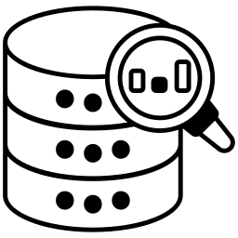



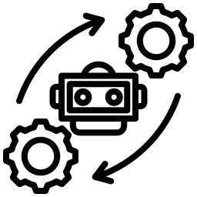


1️⃣ Pick a Data Source
🎯 Find a REST API you like (Stocks, Sports, Pokémon, etc) 📥 This will be your raw data source
2️⃣ Write a Python Script
🐍 Learn basic Python to fetch the API data 📄 Start by saving it to a CSV file for easy handling
3️⃣ Load Data into a Cloud Warehouse
☁️ Sign up for Snowflake or BigQuery (both have free tiers) 📊 Modify your script to send data to your cloud database instead of a CSV
Breaking into
Data Engineering
for FREE!
@ankitrathi
4️⃣ Transform Data with SQL
🔍 Use GROUP BY, JOIN, and Aggregations to structure the data 📌 Write SQL queries to clean & organize it
5️⃣ Automate with Airflow
⏳ Sign up for Astronomer (free tier for Airflow) 🤖 Build an Airflow DAG to schedule & automate your data ingestion
6️⃣ Visualize & Show Off Your Work!
📈 Connect Tableau, Power BI, or Looker to your data warehouse 🎨 Build a cool, auto-updating chart from your dataset

Slide 37





5 Data Anti-Patterns
And How to Avoid Them!
@ankitrathi
1️⃣ The ‘Data-First’ Trap
❌ Collecting data without purpose ✅ Start with a clear business problem, then gather relevant data 📝 Think before you collect!
2️⃣ The ‘AI Silver Bullet’ Fallacy
❌ Believing AI will magically fix data issues ✅ AI is only as good as the data quality & strategy behind it 📝 Bad data in = bad results out!
3️⃣ The ‘Boiling the Ocean’ Syndrome
❌ Trying to fix everything at once ✅ Start with small, impactful wins, then scale up 📝 Focus, solve, iterate!
4️⃣ The ‘Vanity Metrics’ Trap
❌ Tracking numbers that look good but don’t drive decisions ✅ Measure what truly impacts business outcomes 📝 Pretty charts ≠ Real value!
5️⃣ The ‘Spaghetti Junction’ Problem
❌ Messy, tangled, undocumented data pipelines ✅ Keep it clean, structured & well-documented 📝 Future you will thank you!
✨ Key Takeaway:
A strong data strategy avoids these pitfalls and drives real impact!

Slide 38







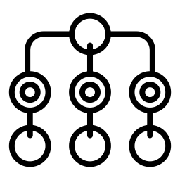
The
Agentic Pipeline
Problem
@ankitrathi
Data Pipelines vs. Agentic Pipelines
🛠 Data Pipelines → Structured, deterministic, and human-supervised 🤖 Agentic Pipelines → Autonomous, probabilistic, and harder to debug
📌 What’s Common?
Both rely on multiple hand-offs
Both struggle with data quality & governance
Both suffer when complexity increases
The Four Big Problems in Agentic Pipelines
❌ Too Many Complex Handoffs
Agents pass data to other agents without clear oversight
Each step adds uncertainty & potential errors ❌ Transformations Without Transparency
No clear visibility into what each agent is doing
Difficult to track errors or debug failures ❌ No Visibility Into Downstream Use
Who uses the data? How is it consumed?
Without human oversight, errors go unnoticed until it’s too late
❌ Ripple Effects – One Error = System-Wide Chaos
A single issue can cascade across all dependent agents
Errors multiply, making debugging a nightmare
The Solution: AI Governance & Contracts
✅ Define clear AI contracts for:
Data inputs & expected format
Prompts & model constraints
Expected outputs & downstream dependencies
🔑 Without guardrails, agentic pipelines will spiral out of control!
Final Thought:
💡 Agentic Pipelines Nightmares >> Data Pipeline Problems If we don’t solve governance now, trust in AI-driven systems will collapse!

Slide 39

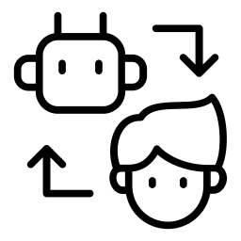














The
AI Productivity
Paradox
@ankitrathi
The Promise vs. The Reality
❓ What AI Vendors Claim:
"AI can make work 10x or 100x faster!"
"A task that took 100 days will now take 1!"
"AI will replace entire teams!"
💡 The Reality:
AI speeds up tasks, but doesn’t eliminate human oversight
Quality, debugging, and integration still take time
More automation = more complexity, not always more efficiency
10
100
AI’s Hidden Cost: Technical Debt
🔥 AI-Generated Code = Piling Up Problems
Messy & redundant code
Security & compliance risks
Hard to debug & maintain
More automation now → Bigger maintenance headaches later
Why Executives Fall for AI Hype
Why do non-tech leaders buy into exaggerated claims?
FOMO – They don’t want to be left behind
AI Magic Effect – Demos look impressive
Marketing Spin – Vendors oversell AI’s capabilities
🔎 Missing Piece: Understanding AI’s Limitations!
The Need for Tech-Savvy Leadership
Smart leaders ask the right questions: What’s the real efficiency gain? How much human oversight is still needed? What’s the long-term cost of AI adoption?
AI is a Tool, Not a Magic Wand
AI can boost productivity, but it’s not a miracle Used wisely, it’s a great assistant Used blindly, it creates more problems than it solves
Think of AI as a power tool – It’s useful, but you still need a skilled worker!

Slide 40











What is AI Ethics?
Study of moral principles that guide the development and use
of AI ensuring it is fair, safe, and accountable while respecting human right
AI is like a powerful car; without ethical “rules of the road,” it can cause harm
Why Does AI Ethics Matter?
Trust – People must trust AI to use it safely Bias & Fairness – Prevent discrimination in AI decisions Privacy – Protect personal data from misuse Accountability – Who is responsible when AI makes mistakes? Safety & Security – AI should not cause harm or be misused
Understanding
AI Ethics
@ankitrathi
Examples of Ethical AI Challenges
Hiring Bias – AI in job screening favouring certain groups unfairly
Deepfakes – AI-generated fake videos spreading misinformation
Facial Recognition – Privacy concerns in surveillance and law enforcement
AI in Warfare – Autonomous weapons making life-and-death decisions
Solutions for Ethical AI
Fair AI Training – Diverse, unbiased training datasets Explainable AI (XAI) – Making AI decisions understandable Regulations & Guidelines – Laws ensuring ethical AI use (like GDPR, AI Act) Human Oversight – AI should assist, not replace, human decision-making AI for Good – Using AI in healthcare, climate change, and education
The Future of AI Ethics
Stronger AI regulations worldwide More transparency in AI systems AI designed for social good and fairness Better AI-human collaboration with ethical safeguards

Slide 41







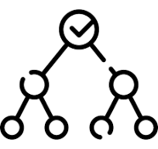




Understanding
XAI
@ankitrathi
What is Explainable AI (XAI)?
AI models often behave like black boxes—the ‘why’ remains missing
XAI aims to make decisions understandable & interpretable
Why Does Explainability Matter?
Trust – for users to trust AI decisions Fairness – to prevent bias & discrimination in AI models Regulations – to abide by Laws (i.e. GDPR) Debugging – to improve AI performance Safety –in healthcare, finance, autonomous systems
How AI Becomes Explainable?
Feature Importance –data points influencing the decision? Decision Trees – breaking down decision path Local vs. Global Explanations
Local: Why was this decision made?
Global: How does the model behave in general? SHAP & LIME – Techniques for interpreting black-box AI Model Transparency – Using simpler, more interpretable models
Trade-offs: Accuracy vs. Explainability
Deep Learning Models (Black Box) - Highly accurate but hard to interpret - Used in image recognition, NLP, etc
Simple Models (Transparent but Less Powerful) - Decision trees, linear regression are more interpretable - Used when explanations are critical (e.g. healthcare, finance)
Challenges & Future of XAI
Trade-off: More explainability can reduce performance Human Interpretation: Even simple explanations can be misunderstood Bias Detection: XAI helps, but bias elimination is tough Future: AI that explains itself in human-like language

Slide 42



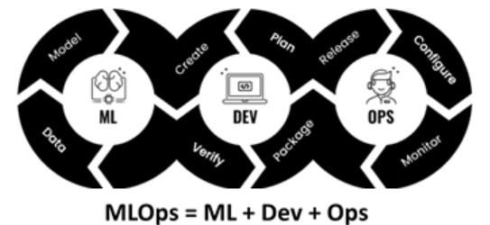
🔍 What is MLOps?
MLOps (Machine Learning Operations) is the practice of streamlining and automating the lifecycle of ML models—from development to deployment and maintenance It ensures scalable, reliable, and efficient ML workflows in production
🚀 Why MLOps Matters?
Scalability → Ensures ML can run across teams & infrastructure Reproducibility → Versioning allows models to be recreated anytime Automation → Reduces manual overhead & human errors Compliance → Helps maintain ethical & legal standards
🛠️ Key Components of MLOps
1️⃣ Data Versioning & Management → Keep track of datasets like code (DVC, Delta Lake) 2️⃣ Model Training & Experimentation → Automate model tracking (MLflow, Weights & Biases) 3️⃣ Continuous Integration & Deployment (CI/CD) → Automate testing & rollouts 4️⃣ Model Monitoring & Drift Detection → Detect concept drift and performance decay 5️⃣ Governance & Compliance → Ensure fairness, explainability & security
⚙️ MLOps Lifecycle
Development → Data prep, model selection, experiments Testing & Validation → Automate performance checks Deployment → Model packaging & serving (Docker, Kubernetes) Monitoring → Track performance & retrain when necessary
Understanding
MLOps
@ankitrathi

Slide 43









Understanding
GenAI
@ankitrathi
What is Generative AI (GenAI)?
A type of AI that can create new content—text, images, music, code, and more—rather than just analyzing data
Like an AI artist, writer, or musician that generates original work based on patterns it has learned.
How Generative AI Works?
Training on Data: AI learns from vast datasets (text, images, code, etc.) Pattern Recognition: Identifies relationships, structures, and styles Content Generation: Uses learned patterns to create new content Refinement & Feedback: Adjusts output based on user input or corrections
Popular Generative AI Models
GPT (Text) – Writes articles, chat responses, and summaries DALL·E (Images) – Creates artwork from text descriptions Codex (Code) – Writes and completes programming code Jukebox (Music) – Generates songs and instrumental music
Challenges & Risks of GenAI
Misinformation – AI can generate fake news & deepfakes Bias & Ethics – AI can reflect biases in its training data Creativity Debate – Is AI-generated content real creativity? Data Privacy – AI models are trained on vast amounts of public data
The Future of Generative AI
More human-like AI assistants Personalized AI-generated content for individuals AI that co-creates with humans in art, music, and writing Ethical guidelines for responsible AI use

Slide 44
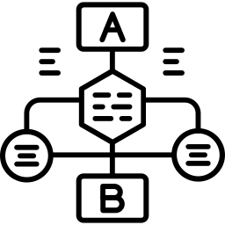




🤖 What is an LLM?
Definition: A Large Language Model (LLM) is an AI system trained on massive text data to understand and generate human-like language Think of it like: A supercharged autocomplete that can write essays, answer questions, and even generate code!
🛠️ How Do LLMs Work?
Training on Big Data → Trained on books, websites, and documents Learning Patterns → Identifies relationships between words Generating Responses → Predicts the next words based on context
🌍 Where Are LLMs Used?
Chatbots & Virtual Assistants → 🤖 Siri, ChatGPT, Google Assistant Content Creation → 📝 Blog writing, copywriting, storytelling Code Generation → 💻 Assisting developers (GitHub Copilot) Data Analysis → 📊 Summarizing reports & extracting insights
⚠️ Challenges & Ethical Concerns
Bias in AI → 🤔 LLMs learn from biased data Misinformation → 🚨 They might generate incorrect or misleading answers Privacy & Security → 🔒 Handling sensitive data responsibly is critical
💡 The Future of LLMs
More accurate, faster, and multimodal AI (text + images + audio) AI that reasons instead of just predicting words Personalized AI models trained on user-specific data
@ankitrathi
Understanding
LLMs

Slide 45

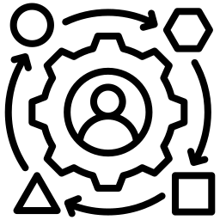




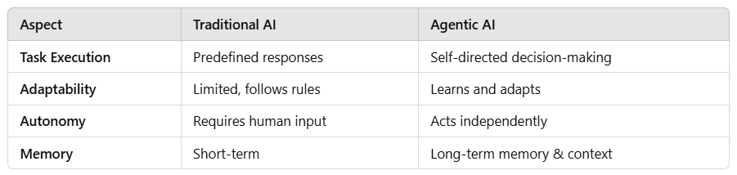


What is Agentic AI?
AI systems that act autonomously, making decisions, setting goals, and taking actions without constant human intervention
Like a self-driving car that plans its route, adapts to traffic, and makes real-time decisions all by itself
Key Features of Agentic AI
Autonomous Decision-Making – sets its own tasks and goals Planning & Reasoning – doesn’t just respond; it strategizes Adaptability & Learning – improves based on feedback Memory & Context Awareness – remembers past interactions Action Execution – takes real-world actions, not just predictions
How Agentic AI Works?
Perception: observes the environment (data, sensors, user input) Decision-Making: determines the best action based on goals Action Execution: performs tasks autonomously Feedback Loop: learns from successes and failures
Understanding
Agentic AI
@ankitrathi
Traditional vs Agentic AI
Challenges & Risks of Agentic AI
Loss of Control – AI taking actions beyond human oversight Ethical Concerns – Who is responsible for AI decisions? Unintended Consequences – AI optimizing for unintended goals Safety & Security – Preventing rogue AI behaviour

Slide 46
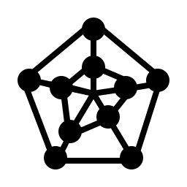






Understanding
Data Mesh
@ankitrathi
What is Data Mesh?
a decentralized approach to data architecture
Moves away from centralized data lakes to domain-driven, self-serve data ownership
Instead of one giant warehouse, each team has its own organized data store
Why Data Mesh? (Benefits)
Scalability – No central team bottleneck Faster Insights – Teams access the data they need without delays Ownership & Quality – Teams take responsibility for reliable, high-quality data Flexibility – Works with data lakes, warehouses, and real-time processing
Core Principles of Data Mesh
Domain-Oriented Ownership – Teams own & manage their data as a product Data as a Product – Treat data like a service with defined consumers & quality standards Self-Serve Infra – Empower teams to store, process, & share data independently Federated Governance – Enforce global security, privacy, and standards
How Data Mesh Works
Each business unit (Finance, Marketing, HR, etc.) manages its own data Data is discoverable, shareable, and reusable across teams
A common platform ensures security & interoperability without central bottlenecks
Challenges of Data Mesh
Cultural Shift – Teams must take ownership of data Standardization Needed – Common governance rules must be enforced Tech Complexity – Requires the right tools for seamless self-service

Slide 47












What is Data Quality?
Data Quality measures how accurate, reliable, and useful data
is for decision-making
Goal: Ensure data is fit for use—complete, consistent, and free from errors.
Like clean water for drinking—bad data leads to bad decisions!
Why Does Data Quality Matter?
Better Decisions – Reliable data leads to accurate insights Fewer Errors – Reduces costly mistakes in business & AI models Compliance & Security – Ensures regulatory compliance (GDPR, HIPAA) Higher Efficiency – Saves time spent fixing bad data
6 Key Dimensions of Data Quality
Accuracy – Data correctly represents real-world facts Completeness – No missing or incomplete values Consistency – Same data across different systems should match Timeliness – Data is up-to-date and available when needed Validity – Data follows rules & formats (e.g., correct date formats) Uniqueness – No duplicate or redundant records
Understanding
Data Quality
@ankitrathi
How to Improve Data Quality?
Data Validation – Check for errors before storing data Deduplication – Remove duplicate records Standardization – Enforce consistent formats and naming conventions Automated Monitoring – Use tools to detect anomalies Data Governance – Clear ownership & accountability for data
Challenges in Maintaining Data Quality
Human Errors – Manual data entry mistakes. Data Silos – Inconsistent data across departments Outdated Data – Old, irrelevant data reducing accuracy Scaling Issues – Maintaining quality as data volume grows

Slide 48







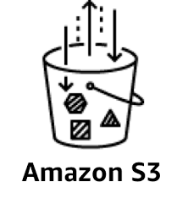




What is Data Engineering?
It is the process of designing, building, and maintaining the systems that collect, store, and process data
Goal: Ensure data is accessible, reliable, and ready for analysis & AI
Like plumbing for data—moving and cleaning data so it's ready for use
Why is Data Engineering Important?
Reliable Data – Ensures accurate, well-structured data for analysis & AI Scalability – Handles large-scale data efficiently Faster Insights – Automates data flow for real-time analytics Foundation for AI – AI & ML models rely on well-prepared data
Key Components of Data Engineering
Data Collection – Extracting data from sources (APIs, databases, logs) Data Storage – Storing data in Data Lakes, Warehouses, or Lakehouses Data Processing – Transforming raw data using ETL (Extract, Transform, Load) / ELT Data Pipelines – Automating data flow using batch & real-time processing Data Quality & Governance – Ensuring accuracy, security, and compliance
Tools & Technologies
Storage: Snowflake, BigQuery, Amazon S3, Delta Lake Processing: Apache Spark, Databricks, dbt, Airflow Pipelines: Kafka, Flink, Fivetran Orchestration: Airflow, Prefect, Dagster
Challenges in Data Engineering
Data Silos – Breaking barriers between isolated data sources Data Quality – Ensuring clean, consistent data Real-Time Processing – Managing speed & reliability Cost & Complexity – Scaling infrastructure efficiently
Understanding
Data Engineering
@ankitrathi

Slide 49










What is Data Analysis?
Process of cleaning, transforming, and interpreting data
To find meaningful patterns, trends, and insights
Goal: Convert raw data into useful knowledge for decision-making
Like solving a puzzle—each data point is a piece that helps complete the big picture
Why is Data Analysis Important?
Better Decision-Making – Data-driven insights lead to smarter choices Problem-Solving – Identifies inefficiencies, risks, and opportunities Predicting Trends – Helps businesses prepare for future changes Competitive Advantage – Effective data analysis outperform others
Types of Data Analysis
Descriptive Analysis – "What happened?" (sales reports, trend charts) Diagnostic Analysis – "Why did it happen?" (correlation, root cause analysis) Predictive Analysis – "What might happen?" (forecasting, machine learning) Prescriptive Analysis – "What should we do?" (decision-making models)
Understanding
Data Analysis
@ankitrathi
Common Data Analysis Techniques
Statistical Analysis – Mean, median, variance, hypothesis testing Data Visualization – Charts, graphs, heatmaps for easy understanding Correlation & Regression – Finding relationships between variables Machine Learning Models – AI-driven pattern recognition Text Analysis – Extracting insights from words and language
Challenges in Data Analysis
Dirty Data – Incomplete, inconsistent, or incorrect data Data Overload – Too much data without clear focus Bias & Misinterpretation – Drawing incorrect conclusions Lack of Skills & Tools – Not everyone is trained in data analysis

Slide 50





Data Engineer ~ The Builder
What They Do? Build data pipelines & manage storage Key Skills: SQL, Python, ETL, Cloud, Big Data Challenges: Dirty data, pipeline failures, scalability
Future Trends: Real-time streaming data, Data Mesh, AI-powered data engineering
Data Analyst ~ The Storyteller
What They Do? Analyze data, create dashboards & reports Key Skills: SQL, Excel, Tableau, Python, Business Acumen Challenges: Messy data, unclear business questions, ad-hoc requests
Future Trends: Self-service analytics, AI-powered BI tools, Automated reporting
Top 5
Data & AI Roles
@ankitrathi
Data Scientist ~ The Predictor
What They Do? Build ML models & derive patterns Key Skills: Python, ML/DL, Statistics, AI Ethics Challenges: Model deployment, bias, explainability
Future Trends: AI explainability, Edge AI, Ethical AI & regulation
AI/ML Engineer ~ The Deployer
What They Do? Deploy, monitor & optimize ML models Key Skills: TensorFlow, Docker, MLOps, Cloud AI Challenges: Model drift, latency, security
Future Trends: Low-latency AI, AI-powered DevOps, Federated Learning
Data/AI Product Manager ~ The Strategist
What They Do? Bridge business & AI, drive AI adoption Key Skills: AI Strategy, Product Management, Communication Challenges: AI ROI, adoption resistance, ethical concerns
Future Trends: AI-driven decision-making, AI governance & compliance, No-code AI platforms

Slide 51
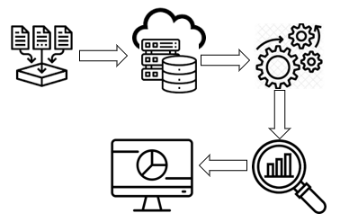




Why is Data Called the “New Oil”?
Like oil in the Industrial Age ~ data is the key resource in the Digital Age
Raw data has no value until processed & refined—just like crude oil
AI & Analytics are the engines that extract value from data
Data is the new oil, AI is the refinery, and insights are the fuel powering businesses
How Businesses Leverage Data & AI
Personalization – Netflix, Amazon, Spotify use AI to recommend content & products Data-Driven Decisions – Companies like Google & Tesla optimize strategies using data insights Automation & AI – Chatbots, fraud detection, and predictive maintenance Monetization – Tech giants sell data-driven advertising & insights (Google, Facebook)
The Data & AI Value Chain
Data Collection – Sensors, IoT, social media, transactions Storage & Processing – Data lakes, warehouses, cloud computing AI & Analytics – Machine learning, deep learning, business intelligence Actionable Insights – Dashboards, reports, predictions Business Impact – Cost savings, revenue growth, innovation
The Future of Data & AI
AI-Powered Everything – AI assistants, automation, autonomous systems Real-Time Decision Making – Edge computing & AI-driven analytics Responsible AI & Ethics – Transparency, fairness, and reducing bias Data Privacy & Security – Regulations like GDPR & AI governance
Challenges & Risks
Data Privacy Issues – Who owns your data? Bias in AI – Unfair outcomes due to biased training data Scalability – Managing the explosion of global data Ethical Concerns – Deepfakes, misinformation, surveillance risks
The Rise of
Data & AI
@ankitrathi

Slide 52




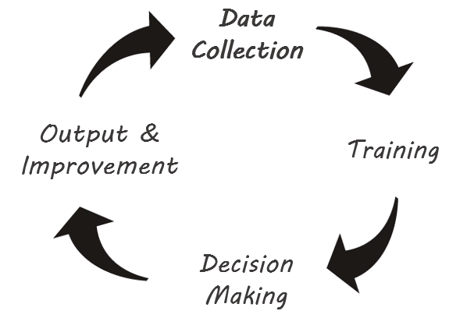






What is AI?
simulation of human intelligence in machines
Learning - Adapts from data
Reasoning - Makes decisions
Self-correction - Improves over time
Types of AI
Narrow AI (Weak AI) → Specialized in one task (Siri, Google Translate)
General AI (Strong AI) → Thinks like a human (still theoretical)
Super AI → More intelligent than humans (future concept)
AI Subfields
Machine Learning (ML) – Learns from data (Netflix recommendations)
Deep Learning (DL) – AI mimicking the human brain (self-driving cars)
Natural Language Processing (NLP) – Understands human language (Chatbots)
Computer Vision – Recognizes images (Face recognition)
How AI Works
Data Collection – AI learns from massive datasets
Training – Models adjust through experience
Decision Making – AI analyzes patterns
Output & Improvement – AI refines predictions over time
AI in Everyday Life
Voice Assistants (Alexa, Google Assistant)
Recommendation Systems (Netflix, YouTube)
Healthcare (Disease diagnosis, robotic surgery)
Autonomous Vehicles (Self-driving cars)
Finance & Security (Fraud detection, stock predictions)
AI Challenges & Ethics
Bias in AI – Unfair outcomes due to biased data
Privacy Issues – AI tracking and surveillance concerns
Job Automation – AI replacing jobs
Ethical AI – Ensuring AI benefits society
Understanding
AI
@ankitrathi

Slide 53








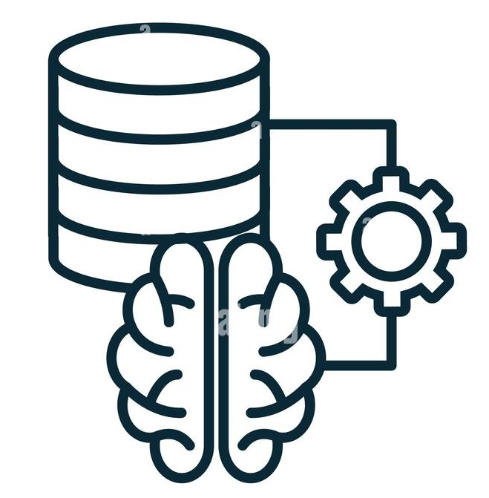





Understanding
Data
@ankitrathi
What is Data?
Its raw information in the form of numbers, text, images, or symbols
Data Formats
Structured (spreadsheets, databases)
Unstructured (emails, videos, social media posts)
Semi-structured (JSON, XML)
Data Processing Cycle
Collection - Sensors, surveys, transactions
Storage - Databases, cloud, servers
Processing - Sorting, filtering, analysing
Analysis - Trends, patterns, insights
Visualization - Graphs, charts, dashboards
Data Types & Examples
Quantitative (Numbers) → Sales figures, temperature
Qualitative (Descriptions) → Customer reviews, comments
Big Data (Massive sets) → Social media trends, IoT sensor data
Importance of Data
Better Decisions - Business strategies, healthcare, AI
Efficiency - Automation, predictive models
Innovation - Machine learning, scientific research
Data Challenges
Data Privacy & Security - Hacks, leaks, GDPR
Data Overload - Too much data, hard to analyze
Bias & Accuracy - Incorrect or misleading data

Slide 54

Analogy with a Car
Data Strategy → GPS & Roadmap
(Defines direction and purpose)
Ensures the organization knows where it’s going with data, aligning it with business goals
Data Architecture → Accelerator
(Speeds things up)
Provides a structured framework that enables fast and scalable data processing
Data Governance → Brakes
(Ensures control and compliance)
Puts guardrails in place to ensure data quality, security, and compliance
Data Engineering → Fuel & Transmission
(Moves data efficiently)
Builds and maintains pipelines that deliver data where it’s needed, ensuring smooth movement
Data Management → Engine Maintenance
(Keeps things running smoothly)
Ensures data is properly stored, processed, and maintained over time
Data Science → Turbocharger
(Adds power and intelligence)
Uses advanced models and algorithms to extract deeper insights and predictions.
Data Analytics → Dashboard & Gauges
(Provides insights to the driver)
Helps monitor performance, trends, and issues to make informed decisions
Understanding
Data & AI
Ecosystem
@ankitrathi

Slide 55
Follow:
@ankitrathi
Literacy
Foundation
Specialization
Bookmark:
Access all Live Notes here
https://github.com/ankit-rathi/The-Data-AI-Visual-Notebook
50+ Visual Notes for FREE

